Slide 1
Human fractions and percentages!
You have 10 minutes to find…
What percentage of the class wear glasses?
What fraction of the class have already had their birthday this year?
What percentage of the class have a pet dog?
What percentage of the class is here today?

Slide 2
Complete your summary by answering the EQ: How do I find the percentage of a number or quantity?
To calculate the percentage of a number first I need to c_____________ the percentage into a _______________.
Then the number _______ needs to become a ________________ over one.
Then I m________________ the fractions using the rules of ________________ _________________.
Notes:
To calculate the percentage of a number first I need to convert the percentage into a fraction. Then the number also needs to become a fraction over one. Then I multiply the fractions using the rules of fraction multiplication.

Slide 3
Topic: Percentages
EQ: How do I calculate what percentage I have?

Slide 4
Topic: Percentages
EQ: How do I calculate what percentage I have?
Questions:
Notes:
Sometimes we want to know the proportion of a certain quantity compared to the whole.
This may be done using a fraction, percentage or ratio.

Slide 5


Topic: Percentages
EQ: How do I calculate what percentage I have?
Questions:
Notes:
What steps do I follow to calculate the proportion as a percentage?
Express one quantity as a fraction of another
Express one quantity as a percentage of another

Slide 6



Example 1
What fraction is shaded red?
What percentage is shaded red?

Slide 7
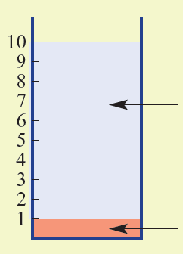
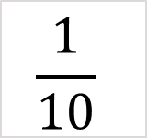
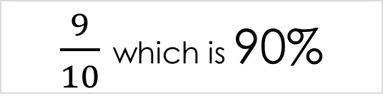
Example 2
A glass of cordial is 1 part cordial to 9 parts water.
a Express the amount of cordial syrup as a fraction of the total.
$$\frac{1}{10}$$
water
b Express the amount of water as a percentage of the total.
$\frac{9}{10}$ which is 90%
Cordial

Slide 8
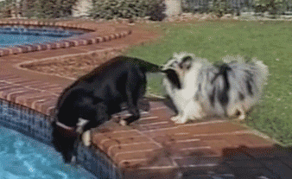
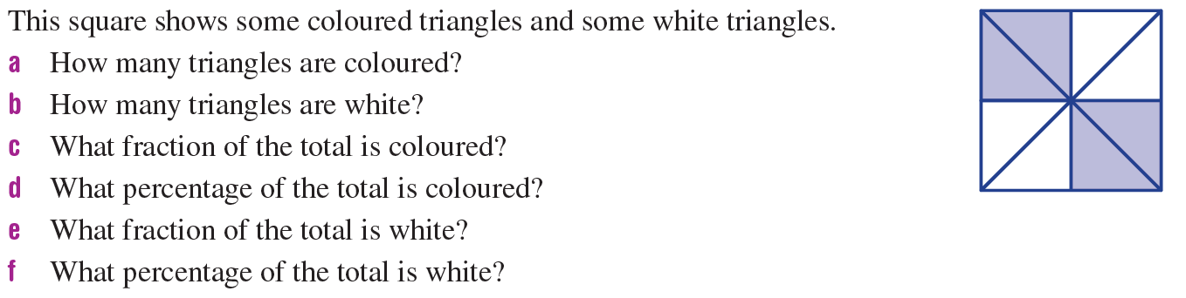
Think-Pair-Share
Left-Hand-Side Task 1

Slide 9
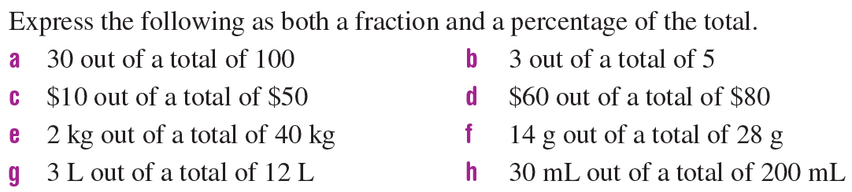
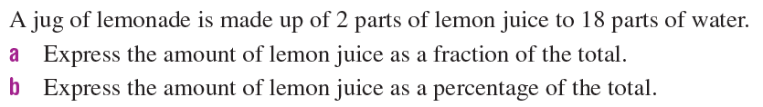
Left-Hand-Side Task 2
1.
2.

Slide 10
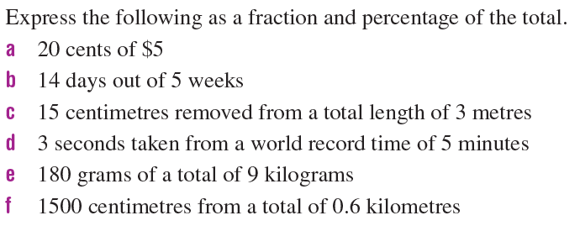
Left-Hand-Side Task 3
3.
4.
5.

